Slide 1
Scale Invariant Feature Transform (SIFT)
CS 763
Ajit Rajwade

Slide 2
What is SIFT?
It is a technique for detecting salient, stable feature points in an image.
For every such point, it also provides a set of “features” that “characterize/describe” a small image region around the point. These features are invariant to rotation and scale.

Slide 3
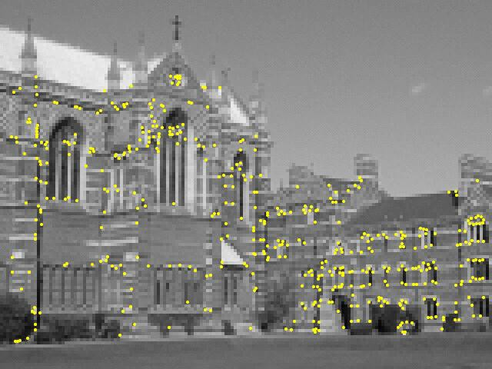
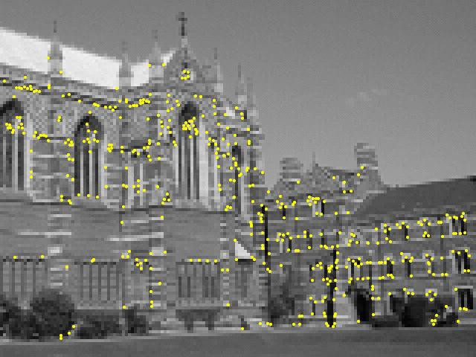
Motivation for SIFT
Image matching
Estimation of affine transformation/homography between images
Estimation of fundamental matrix in stereo
Structure from motion, tracking, motion segmentation

Slide 4
Motivation for SIFT
All these applications need to (1) detect salient, stable points in two or more images, and (2) determine correspondences between them.
To determine correspondences correctly, we need some features characterizing a salient point.
These features must not change with:
Object position/pose
Scale
Illumination
Minor image artifacts/noise/blur

Slide 5
Motivation for SIFT
Individual pixel color values are not an adequate feature to determine correspondences (why?).

Slide 6
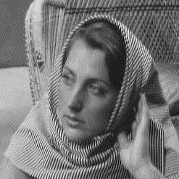
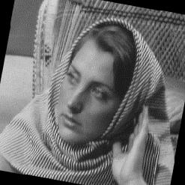
Motivation for SIFT
One could try matching patches around the salient feature points – but these patches will themselves change if there is change in object pose or illumination.
So these patches will lead to several false matches/correspondences.

Slide 7
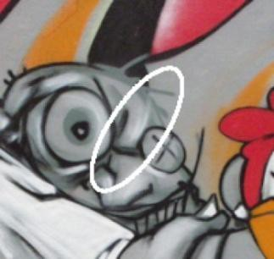
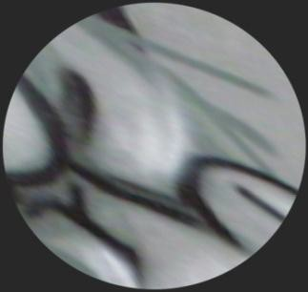
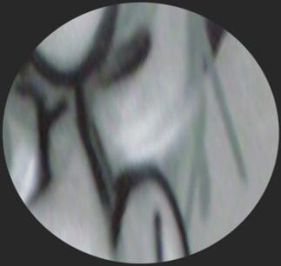
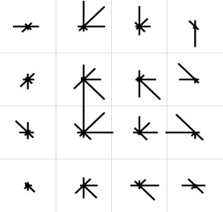
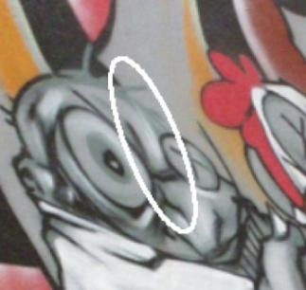
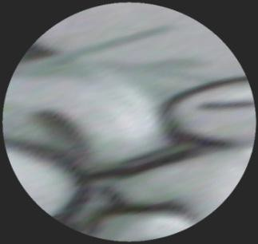
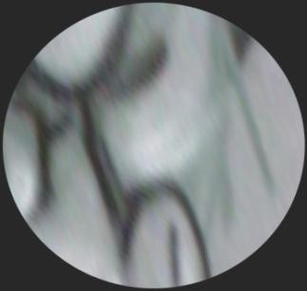
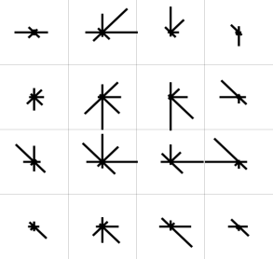
Motivation for SIFT
SIFT provides features characterizing a salient point that remain invariant to changes in scale or rotation.
Image taken from slides by George Bebis (UNR).

Slide 8
Steps of SIFT algorithm
Determine approximate location and scale of salient feature points (also called keypoints)
Refine their location and scale
Determine orientation(s) for each keypoint.
Determine descriptors for each keypoint.

Slide 9
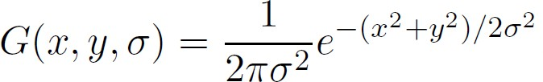
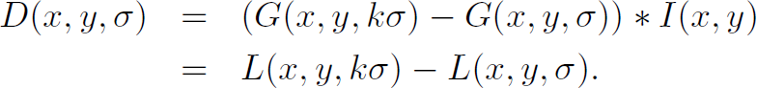
Step 1: Approximate keypoint location
Look for intensity changes using the difference of Gaussians at two nearby scales:
Convolution operator: refers to the application of a filter (in this case Gaussian filter to an image)
Difference of Gaussians = “DoG”.
Scale refers to the σ of the Gaussian.

Slide 10
This is a 7 x 7 (truncated) Gaussian mask with mean zero and standard deviation σ = 2.
0.0049 | 0.0092 | 0.0134 | 0.0152 | 0.0134 | 0.0092 | 0.0049
0.0092 | 0.0172 | 0.0250 | 0.0283 | 0.0250 | 0.0172 | 0.0092
0.0134 | 0.0250 | 0.0364 | 0.0412 | 0.0364 | 0.0250 | 0.0134
0.0152 | 0.0283 | 0.0412 | 0.0467 | 0.0412 | 0.0283 | 0.0152
0.0134 | 0.0250 | 0.0364 | 0.0412 | 0.0364 | 0.0250 | 0.0134
0.0092 | 0.0172 | 0.0250 | 0.0283 | 0.0250 | 0.0172 | 0.0092
0.0049 | 0.0092 | 0.0134 | 0.0152 | 0.0134 | 0.0092 | 0.0049
Convolution means the following (non-rigorously):
Let the original image be A. Let the new image be B. You move the mask all over the image
A. Let us suppose the mask is centered at location (i,j) in image A. You compute the point- wise product between the mask entries and the corresponding entries in A. You store the sum of these products in B(i,j).
B(i, j) = ∑ ∑ A(i − a, j − b)M (a, b)
a=− rb=−r
Whenever you are performing a filtering operation on image, the resultant image is obtained by convolving the original image with the filter, and is said to be the response to the filter.
For further details, refer to Section 3.4 of the book on Digital Image Processing by Gonzalez, or see the animation at: http://en.wikipedia.org/wiki/Convolution
r r

Slide 11
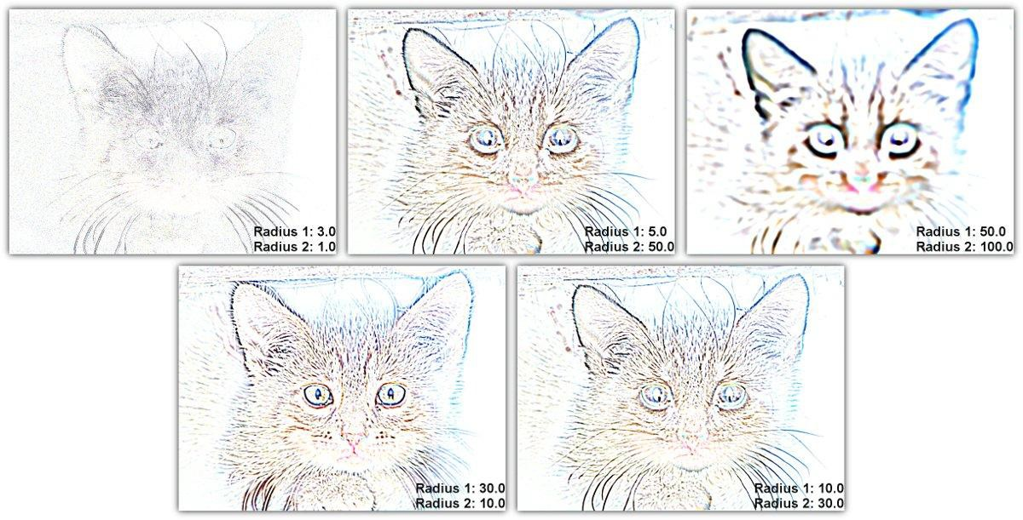
http://www.gimpbible.com/files/edge-detection-difference-of-gaussians/
This is an example of the DoG filter in gimp. In SIFT, however, the DoG is
computed from Gaussians at nearby scales.

Slide 12
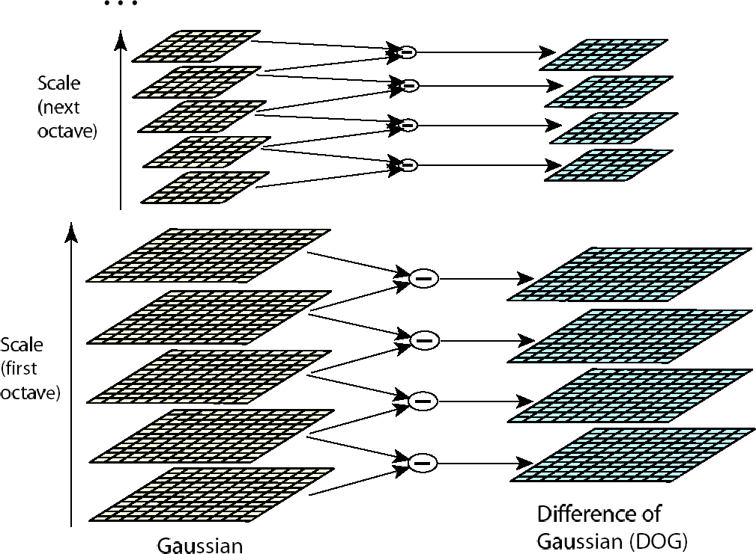
Step 1: Approximate keypoint location
D(x, y,σ ) =
L(x, y, kσ ) − L(x, y,σ )
L(x, y,σ ) =
G(x, y,σ )* I (x, y)
Down- sampling
Octave = doubling of σ₀. Within an octave, the adjacent scales differ by a constant factor k. If an octave contains s+1 images, then k = 2^{(1/s)}. The first image has scale σ₀, the second image has scale kσ₀, the third image has scale k²σ₀, and the last image has scale k^{s}σ₀. Such a sequence of images convolved with Gaussians of increasing σ constitute a so-called scale space.

Slide 13
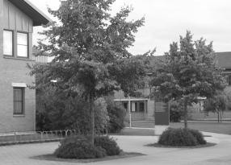

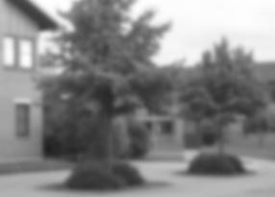

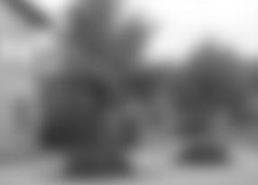

Scale = 0
Scale = 1
Scale = 4
Scale = 16 Scale = 64
http://en.wikipedia.org/wiki/Scale_space
Scale = 256

Slide 14
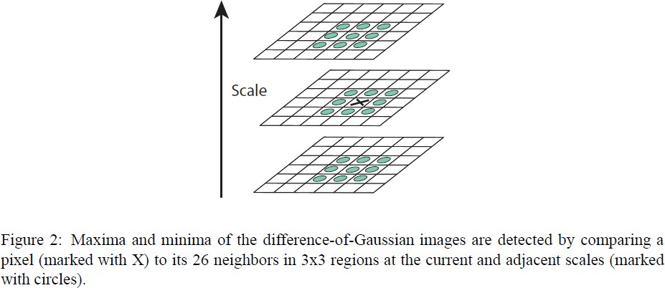
Step 1: Approximate keypoint location
Image taken from D. Lowe, “Distinctive Image Features from Scale-Invariant
Points”, IJCV 2004
The keypoints are maxima or minima in the “scale-space-pyramid”,
i.e. the stack of DoG images. Hereby, you get both the location as well as the scale of the keypoint.

Slide 15
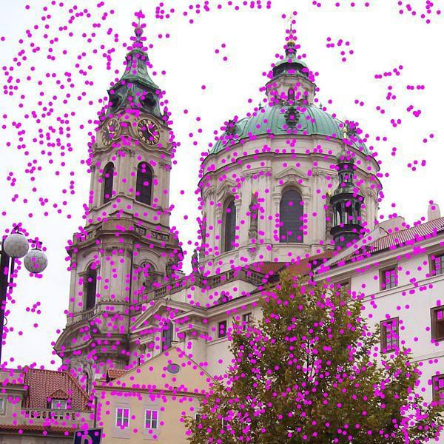
Initial detection of keypoints
http://upload.wikimedia.org/wikipedia/commons/4/44/Sift_keypoints_filtering.jpg

Slide 16
Step 2: Refining keypoint location
The keypoint location and scale is discrete – we can interpolate for greater accuracy.
For this, we express the DoG function in a small 3D neighborhood around a keypoint (x_{i},y_{i},σ_{i}) by a second-order Taylor-series:
⎛ ∂D( x, y,σ ) ⎞^{T}
1 ⎛ ∂² D( x, y,σ ) ⎞
2 ⎝ ∂( x, y,σ )
D( x, y,σ ) = D( x , y ,σ ) +
⎜
⎝
⎟ Δ +
x= x ,
Δ^{T} ⎜
⎟
Δ;
i i i
∂( x, y,σ )
⎜
2
⎟
⎠
i
⎠
x= x ,
y= y_{i} ,
i
y= y_{i} ,
σ =σ_{i}
σ =σ_{i}
⎛ x − x_{i} ⎞
Δ = ⎜ y − y ⎟
⎜ i ⎟
Gradient vector evaluated digitally at the keypoint
3 x 3 Hessian matrix evaluated digitally at the keypoint
⎜σ − σ ⎟
⎝
i ⎠

Slide 17
Step 2: Refining keypoint location
To find an extremum of the DoG values in this neighborhood, set the derivative of D(.) to 0. This gives us:
⎛ xˆ ⎞
−1
⎜ ⎟
⎛ ∂² D( x, y,σ ) ⎞
⎛ ∂D( x, y,σ ) ⎞
⎜ yˆ ⎟ = −⎜
⎟ ⎜
⎟
x= x ,
⎜_{σˆ} ⎟
⎝ ∂( x, y,σ )
2
⎠
x= x ,
⎝ ∂( x, y,σ ) _{⎠ y=} ^{i}
i
y ,
⎝ ⎠
y= y_{i} ,
i
σ =σ_{i}
σ =σ_{i}
T
⎛ xˆ ⎞
_{= D( x , y ,σ ) +} 1 ⎛ ∂D( x, y,σ ) ⎞
⎜ ⎟
⎟ ⎜ yˆ
x= x ,
∴ D
⎜
⎟
extremal
i i i
2 ⎝ ∂( x, y,σ ) _{⎠ y=} ^{i}
y , ⎜ ⎟
σ
ˆ
i
⎝ ⎠
σ =σ
i
The keypoint location is updated.
All extrema with |D_{extremal}| < 0.03, are discarded as “weak extrema” or “low contrast points”.

Slide 18
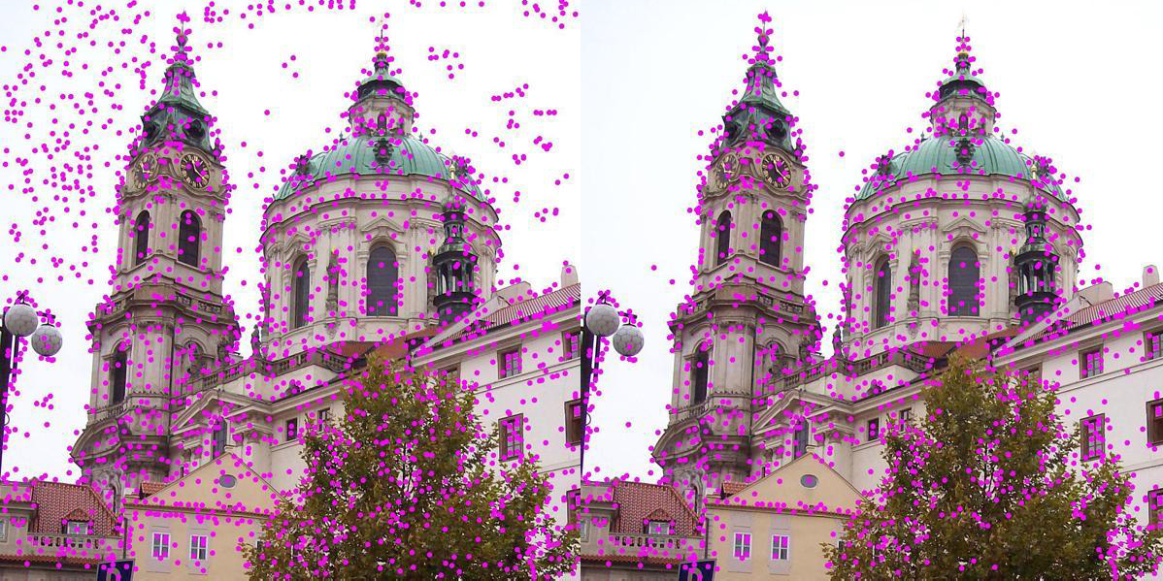
Removal of low-contrast keypoints
http://upload.wikimedia.org/wikipedia/commons/4/44/Sift_keypoints_filtering.jpg

Slide 19
Step 2: Refining keypoint location
Some keypoints reside on edges, as edges always give a high response to a DoG filter.
But edges should not be considered salient points (why?).
So we discard points that lie on edges.
In the case of KLT tracker, we saw how to detect points lying on salient edges using the structure tensor.

Slide 20
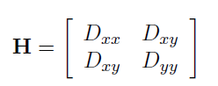
Step 2: Refining keypoint location
The SIFT paper uses the 2nd derivative matrix (called the Hessian matrix):
The eigenvalues of H give a lot of information about the local structure around the keypoint.
In fact, the eigenvalues are the maximal and minimal principal curvatures of the surface D(x,y), i.e. of the DoG function, at that point.
http://en.wikipedia.org/wiki/File:Minimal_surface_curvature_planes-en.svg
http://en.wikipedia.org/wiki/Principal_curvature

Slide 21
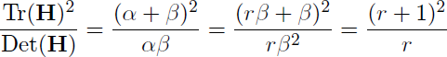
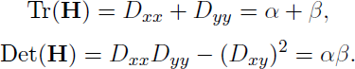
Step 2: Refining keypoint location
An edge will have high maximal curvature, but very low minimal curvature.
A keypoint which is a corner (not an edge) will have high maximal and minimal curvature.
The following can be regarded as an edge-ness measure:
Should be less than a threshold
(say 10).
For an edge, α >> β, leading to a large value of this measure.
Why this measure instead of r? To save computations – we need not compute eigenvalues!

Slide 22
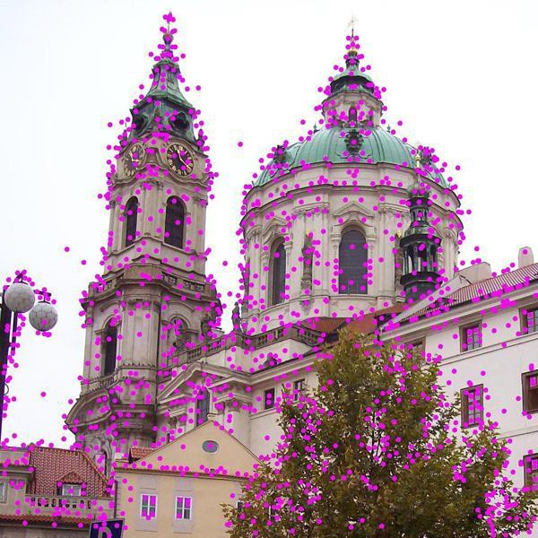
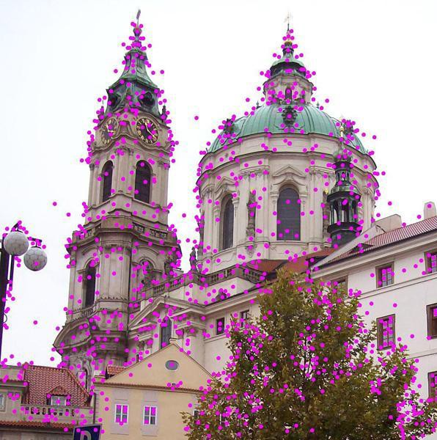
Removal of high-contrast keypoints residing on edges
http://upload.wikimedia.org/wikipedia/commons/4/44/Sift_keypoints_filtering.jpg

Slide 23
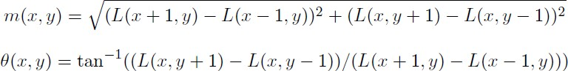
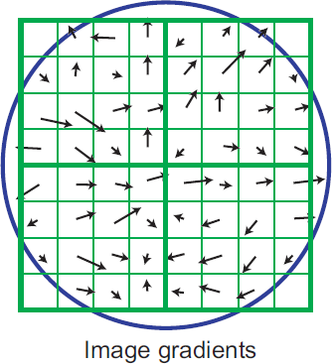
Step 3: Assigning orientations
Compute the gradient magnitudes and orientations in a small window around the keypoint – at the appropriate scale.
35
Histogram of gradient orientation – the bin-counts are weighted by gradient magnitudes and a Gaussian weighting function. Usually, 36 bins are chosen for the orientation.
30
25
20
15
10
5
0
-0.5
0
0.5
1
1.5
2
2.5
3
3.5

Slide 24
Step 3: Assigning orientations
Assign the dominant orientation as the orientation of the keypoint.
In case of multiple peaks or histogram entries more than 0.8 x peak, create a separate descriptor for each orientation (they will all have the same scale and location).
35
Histogram of gradient orientation – the bin-counts are weighted by gradient magnitudes and a Gaussian weighting function. Usually, 36 bins are chosen for the orientation.
30
25
20
15
10
5
0
-0.5
0
0.5
1
1.5
2
2.5
3
3.5

Slide 25
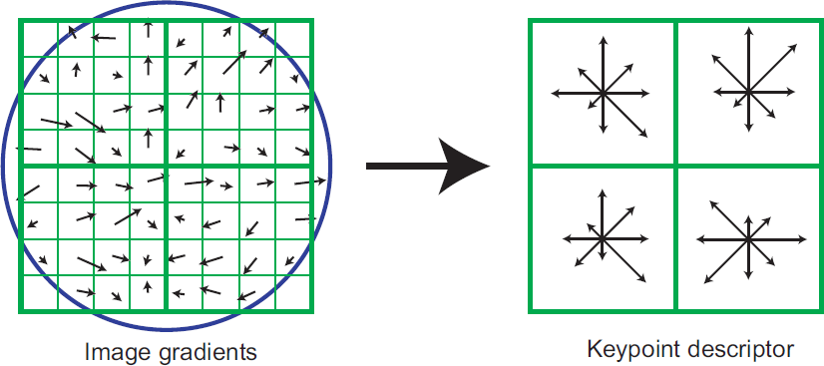
Step 4: Descriptors for each keypoint
Consider a small region around the keypoint. Divide it into n x n cells (usually n = 2). Each cell is of size 4 x 4.
Build a gradient orientation histogram in each cell. Each histogram entry is weighted by the gradient magnitude and a Gaussian weighting function with σ = 0.5 times window width.
Sort each gradient orientation histogram bearing in mind the dominant orientation of the keypoint (assigned in step 3).
Image taken from D. Lowe, “Distinctive Image Features from Scale-Invariant
Points”, IJCV 2004

Slide 26
Step 4: Descriptors for each keypoint
We now have a descriptor of size rn² if there are r bins in the orientation histogram.
Typical case used in the SIFT paper: r = 8, n = 4, so length of each descriptor is 128.
The descriptor is invariant to rotations due to the sorting.
Image taken from D. Lowe, “Distinctive Image Features from Scale- Invariant
Points”, IJCV
2004

Slide 27
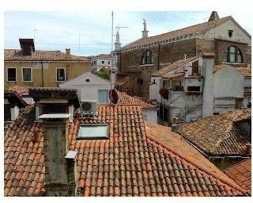
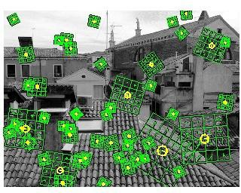
Step 4: Descriptors for each keypoint
For scale-invariance, the size of the window should be adjusted as per scale of the keypoint. Larger scale = larger window.
Image taken from D. Lowe, “Distinctive Image Features from Scale-Invariant
Points”, IJCV 2004
http://www.vlfeat.org
/overview/sift.html

Slide 28
Step 4: Descriptors for each keypoint
The SIFT descriptor (so far) is not illumination invariant – the histogram entries are weighted by gradient magnitude.
Hence the descriptor vector is normalized to unit magnitude. This will normalize scalar multiplicative intensity changes.
Scalar additive changes don’t matter – gradients are invariant to constant offsets anyway.
Not insensitive to non-linear illumination changes.

Slide 29
Step 1: Keypoint computations? (More details)
Why are DoG filters used?
The Gaussian filter (and its derivatives) is shown to be the only filter obeys all of the following:
Linearity
Shift-invariance
Structures at coarser scales are related to structures at finer scales in a consistent way (smoothing process does not produce new structures)
Rotational symmetry
Semi-group property:
G(x, y,σ₁)*G(x, y,σ₂ ) = G(x, y,σ₁ + σ₂ )
✓ + some other properties
http://en.wikipedia.org/wiki/Scale_space

Slide 30
Step 1: Keypoint computations? (More details)
Why difference of Gaussians?
The DoG is an approximation to the scale- multiplied Laplacian of Gaussian filter in image processing – a rotationally invariant filter.
The DoG is a good model for how neurons in the retina extract image details to be sent to the brain for processing.

Slide 31
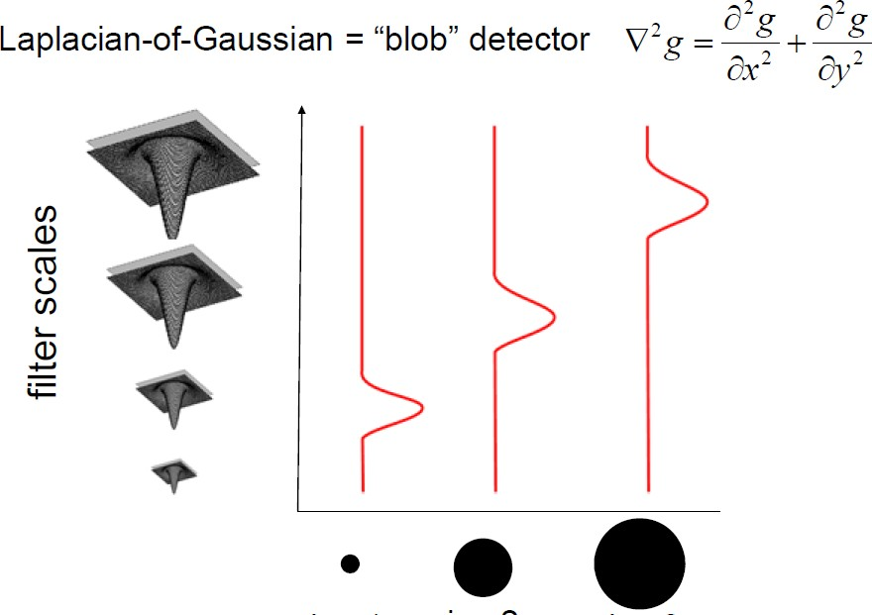
LoG filter of scale σ produces strong responses for patterns of radius σ * sqrt(2).
http://www.cs.utexas.edu/~grauman/courses/spring2011/slides/lecture14_localfeats.pdf

Slide 32
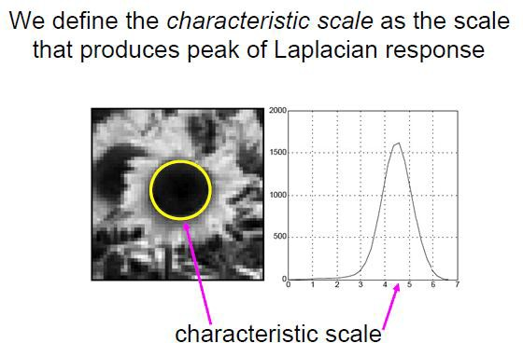
Keypoint = center of blob
http://www.cs.utexas.edu/~grauman/courses/spring2011/slides/lecture14_localfeats.pdf

Slide 33
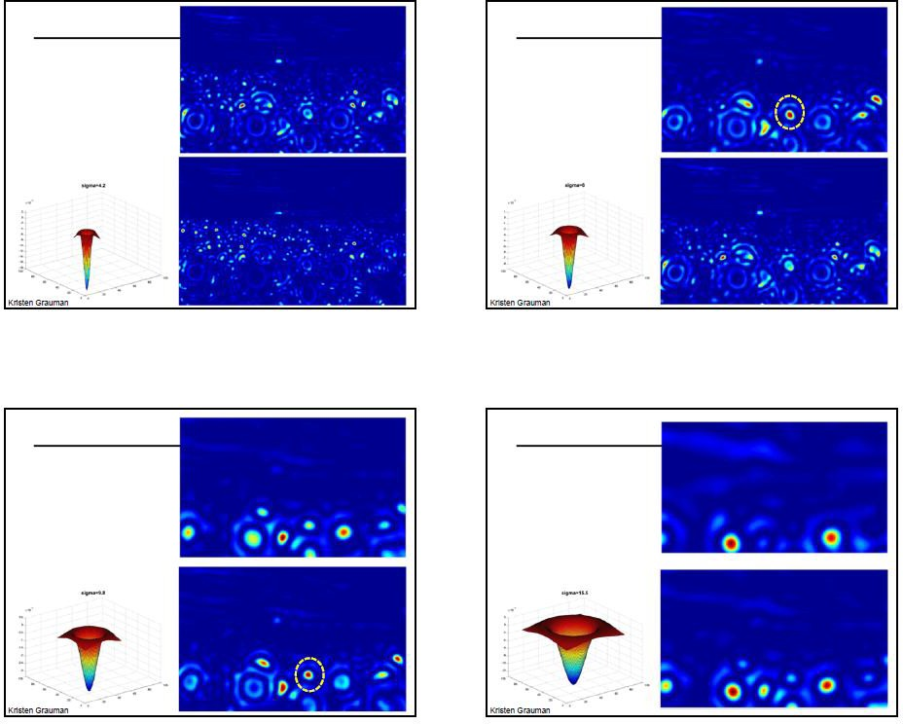
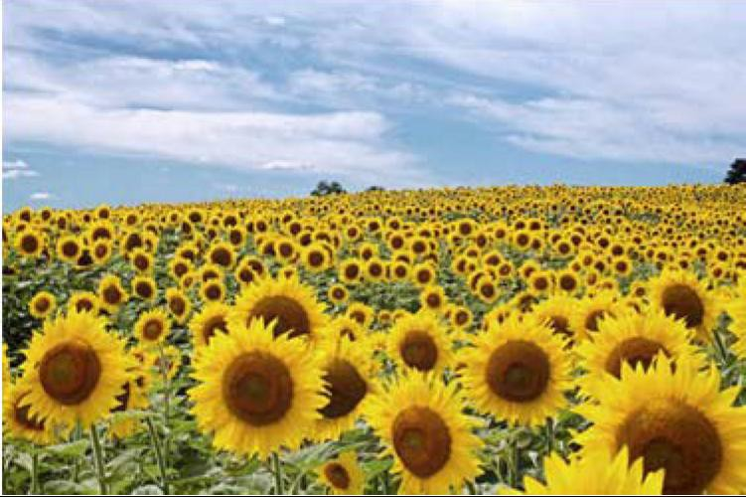
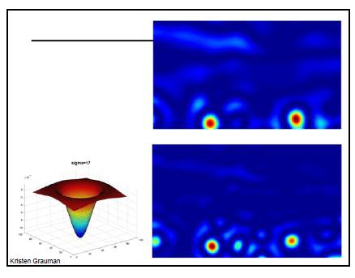
http://www.cs.utexas.edu/~grauman/courses
/spring2011/slides/lecture14_localfeats.pdf

Slide 34
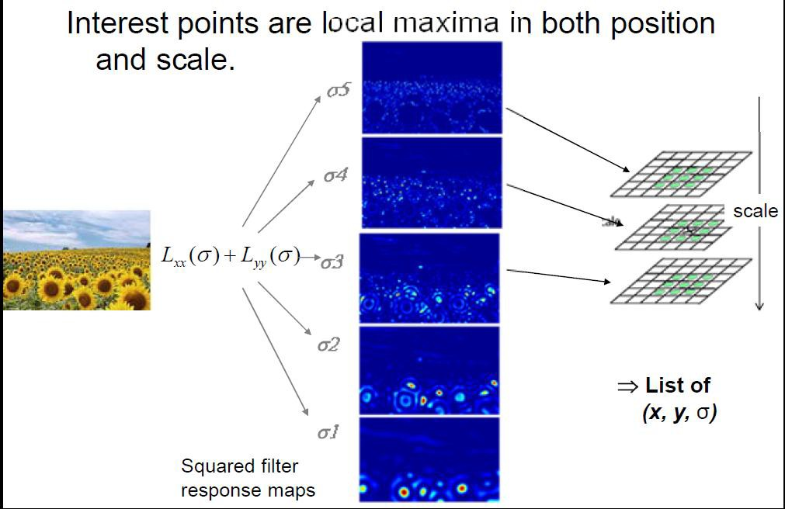
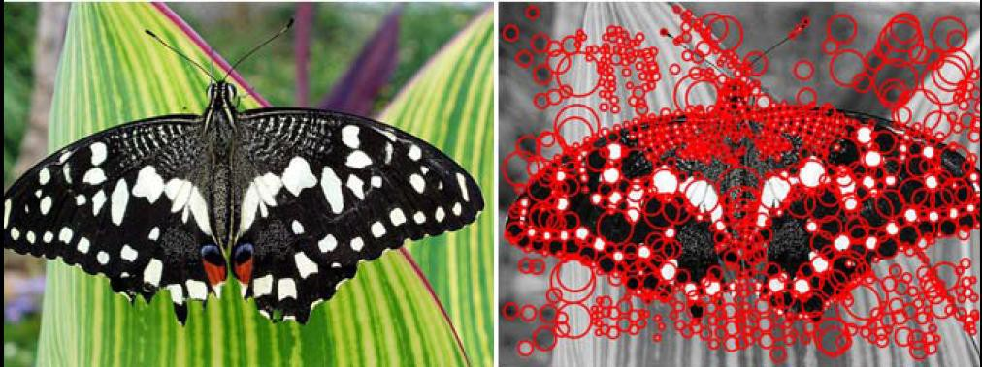
http://www.cs.utexas.edu
/~grauman/courses/spring 2011/slides/lecture14_loc alfeats.pdf

Slide 35
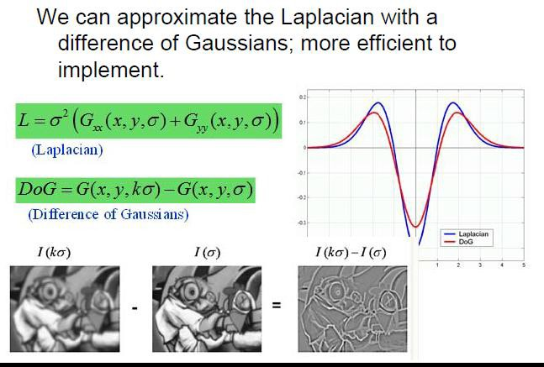
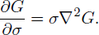
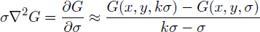
http://www.cs.utexas.edu
/~grauman/courses/spring 2011/slides/lecture14_loc alfeats.pdf
= G_{xx} + G_{yy}
Isotropic heat equation: running this equation on an image is equivalent to smoothing the image with a Gaussian.
Numerical approximation

Slide 36
Step 1: Keypoint computations? (More details)
Why do we look for extrema of the DoG function?
Maxima of the DoG indicate dark points (blobs) on a bright background.
Minima of the DoG indicate bright points (blobs) on a dark background.
Why do we look for extrema in a spatial as well as scale sense?
It helps us pick the “scale” associated with the keypoint!

Slide 37
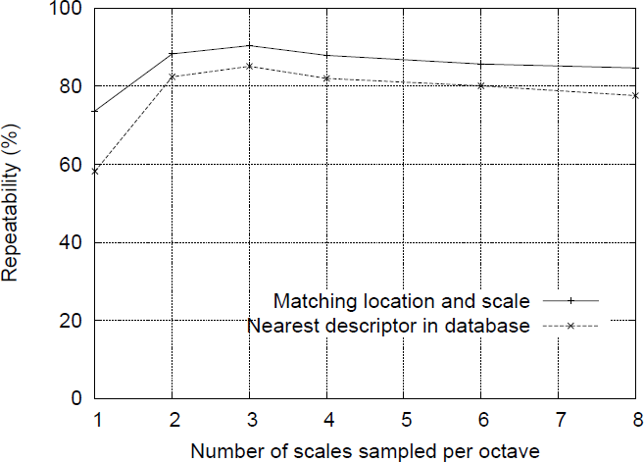
Step 1: Keypoint computations?
How many scales per octave? Answer: 3 – it is empirically observed that this provides optimal repeatability under downsampling/upsampling/rotation of the image as well as image noise.
Image taken from D. Lowe, “Distinctive Image Features from Scale-Invariant
Points”, IJCV 2004

Slide 38
Step 1: Keypoint computations?
Adding more scales per octave will increase the number of detected keypoints, but this does not improve the repeatability (in fact there is a small decrease) – so we settle for the computationally less expensive option.

Slide 39
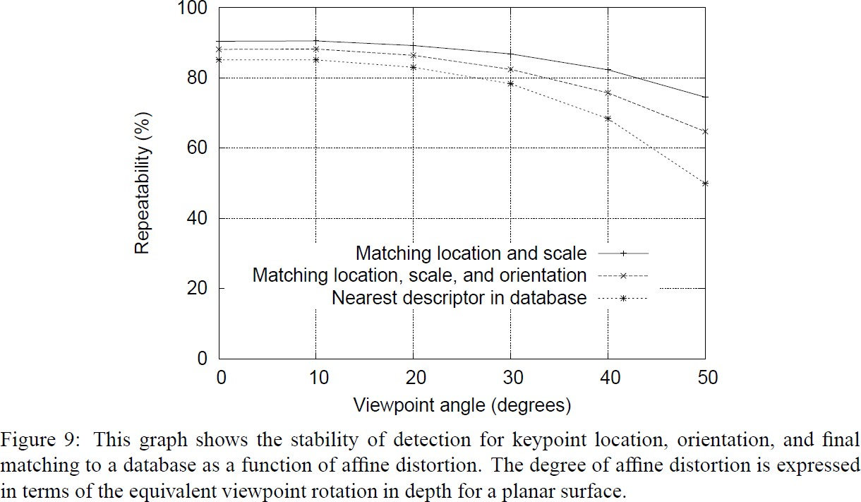
Summary of SIFT descriptor properties
Invariant to spatial rotation, translation, scale.
Experimentally seen to be less sensitive to small spatial affine or perspective changes.
Invariant to affine illumination changes.
Image taken from D. Lowe, “Distinctive Image Features from Scale-Invariant
Points”, IJCV 2004

Slide 40
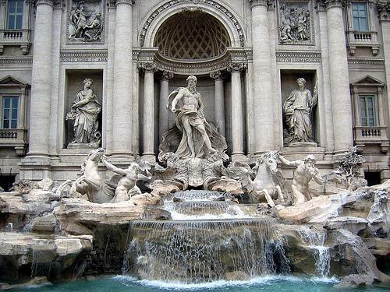
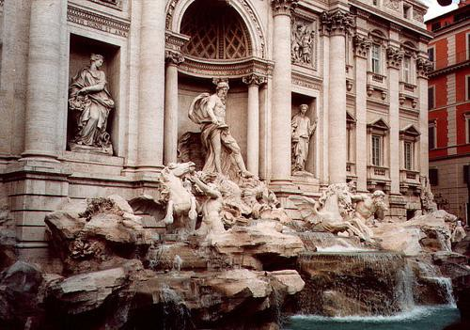
Application: Matching SIFT descriptors
Given a keypoint descriptor in image 1, find its nearest neighbor in image 2. “Nearest” as defined typically by SSD:
rn²
1 2 ∑ 1
2
d (a , a ) =
(a (i) − a (i))
2
i=1
I₁
I₂
Threshold the distance to decide whether the matching pair was valid.

Slide 41
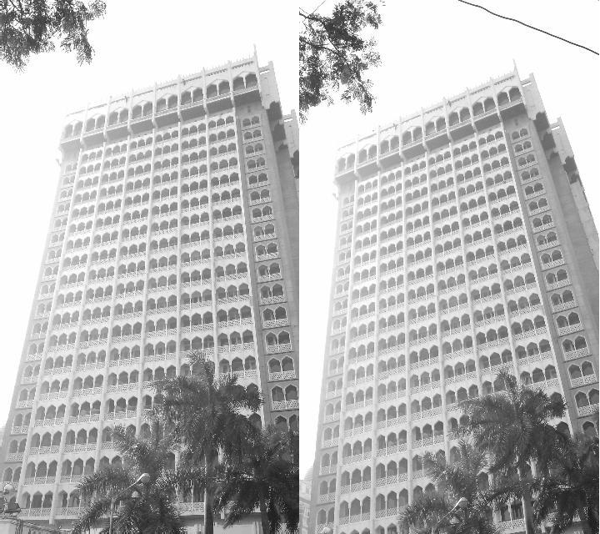
Application: Matching SIFT descriptors
May lead to many false matches.

Slide 42
Application: Matching SIFT descriptors
Consider the match between the keypoints to be valid if and only if the second nearest neighbor distance (SNND) in image 2 is sufficiently larger than the nearest neighbor distance (NND).
Accept match as valid if SNND/NND > 0.8 (see next slide).

Slide 43
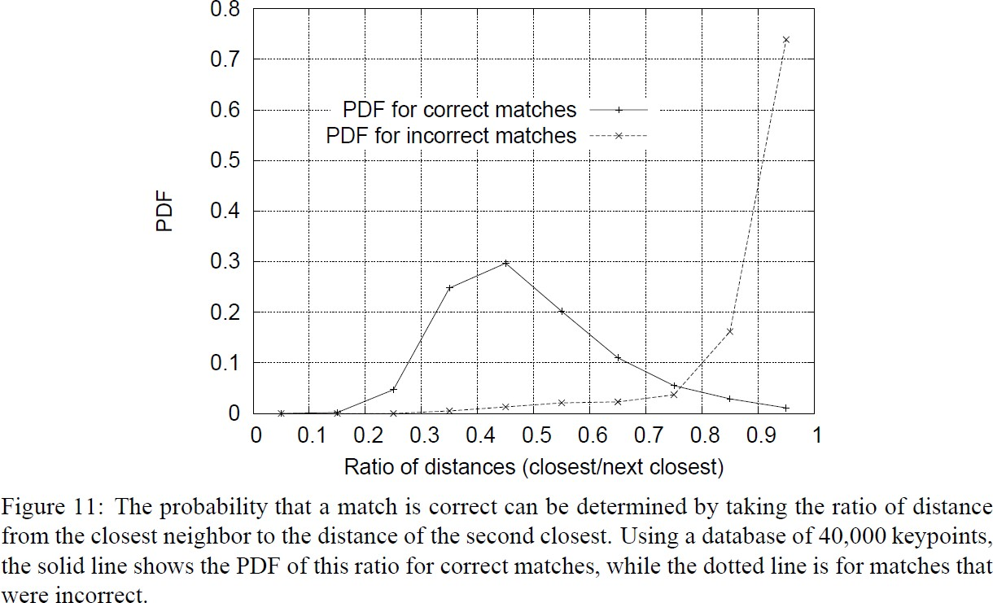
Image taken from D. Lowe, “Distinctive Image Features from Scale-Invariant Points”, IJCV 2004

Slide 44
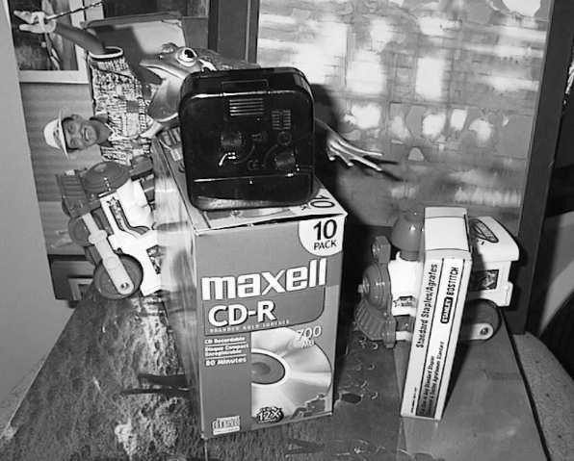
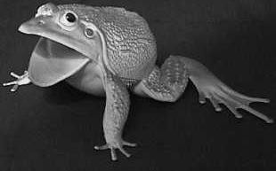

Application: Object Recognition
Input (1): A reference database of images of various objects. Each image is labeled by object name and object pose + scale.
Input (2): Query images in which you locate one or more of these objects.

Slide 45
Application: Object Recognition
Compute and store keypoints and their descriptors for each image in the reference database.
Compute keypoint descriptors for the query image.
For each keypoint, find the nearest matching descriptor in each image of the reference database subject to the SNND/NND constraint.

Slide 46
Application: Object Recognition
Collect all keypoints in the query image that “vote for” a particular pose for object X in the reference database.
“Vote for pose abc of object X” = “have a nearest neighbor in image of object X with pose θ (say)”

Slide 47

Application: Object Recognition
Estimate an affine transformation between keypoint locations (x_{i},y_{i}) from the query image and keypoint locations (u_{i},v_{i}) for each candidate reference image.
Verify the affine transformation: apply the transform to the keypoints and compute the difference between the transformed and target locations. Discard the point as an outlier if the difference between the orientations/scales/locations is too high.

Slide 48
Application: Object Recognition
What is too high?
Orientation difference > 20 degrees
Scale difference more than 1.5
Location difference > 0.2 * size of model
Repeat the solution for affine transformation until no more points are thrown out.
If number of points < 3, affine transformation cannot be estimated.

Slide 49


Slide 50


Slide 51
SIFT: ++ ☺
Resistant to affine transformations of limited extent (works better for planar objects than full 3D objects).
Resistant to a range of illumination changes
Resistant to occlusions in object recognition, since SIFT descriptors are local.

Slide 52
SIFT: ☹
Resistance to affine transformations is empirical – no hard-core theory provided.
Several parameters in the algorithm: descriptor size, size of the region, various thresholds – theoretical treatment for their specification not clear.

